Slide 1
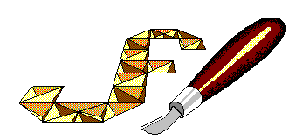
Chip Carving
Jeff Fleisher
(540) 740-4602
jeff@jeffswooddesigns.com
www.jeffswooddesigns.com

Slide 2
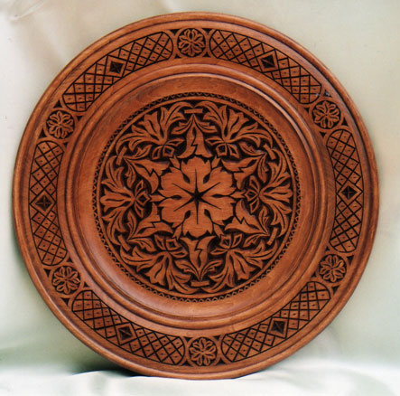
History
Dates back to prehistoric civilizations
Modern Chip Carving originated in Europe
known as Kerbschnitzen or ‘engraving carving’ in Germany & Switzerland
Used to decorate wooden tools, furniture, kitchen & farming utensils (water buckets, breadboards, spoons, milking stools, cupboards,...)
Today it is a decorative art form
Modern 3-cut technique popularized by Wayne Barton

Slide 3
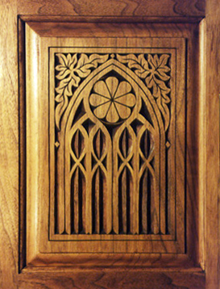
Design
Designs are based upon
triangles
geometric curves
freeform lines
To Create
geometric shapes
rosettes
free form shapes
letters
On
plates
boxes
furniture
plus much more....

Slide 4
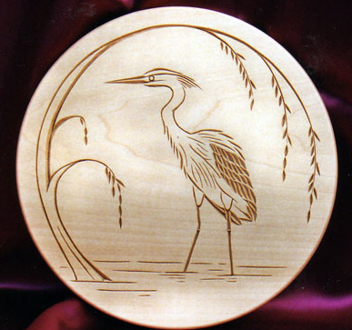
Tools
Two Knives
cutting knife - used to make all cuts both straight and curved
stab knife - only used to indent or impress a mark in the wood to create or enhance a design
Tools to sharpen & Shape the cutting knife
Drawing tools
compass
ruler
lead pencil (grade ‘B’, 0.5 mm lead)
eraser
graphite paper

Slide 5
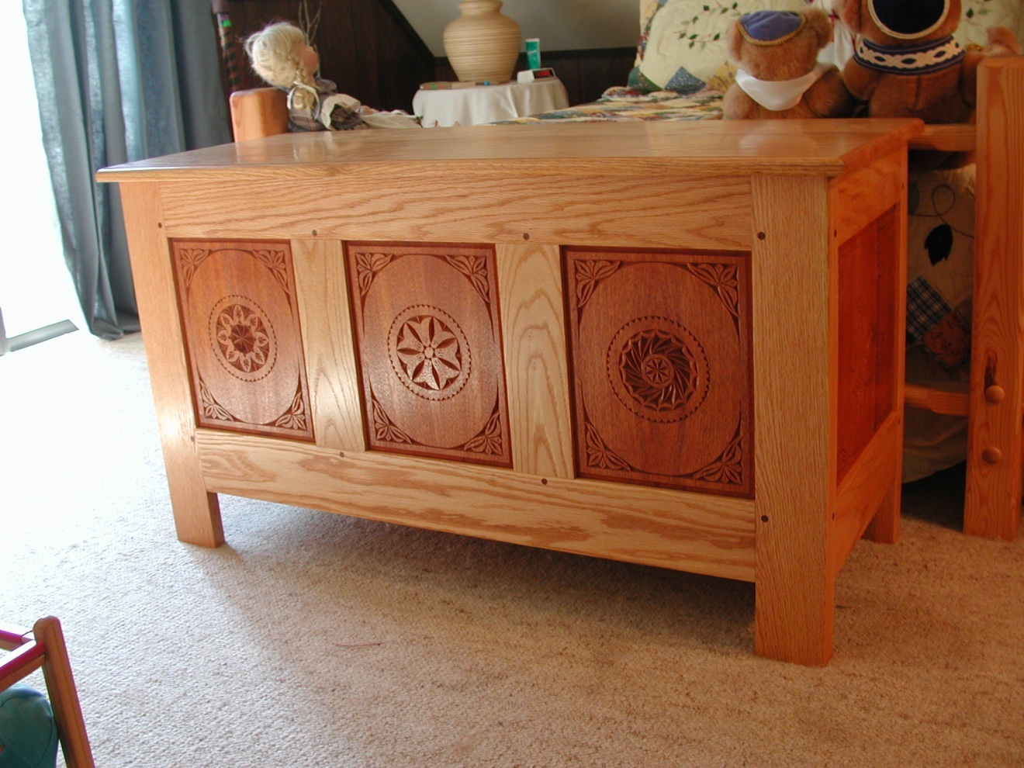
Chip Carving Examples

Slide 6
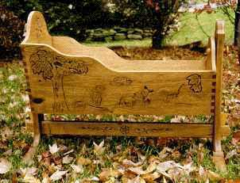
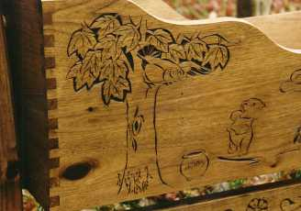
Chip Carving Examples

Slide 7
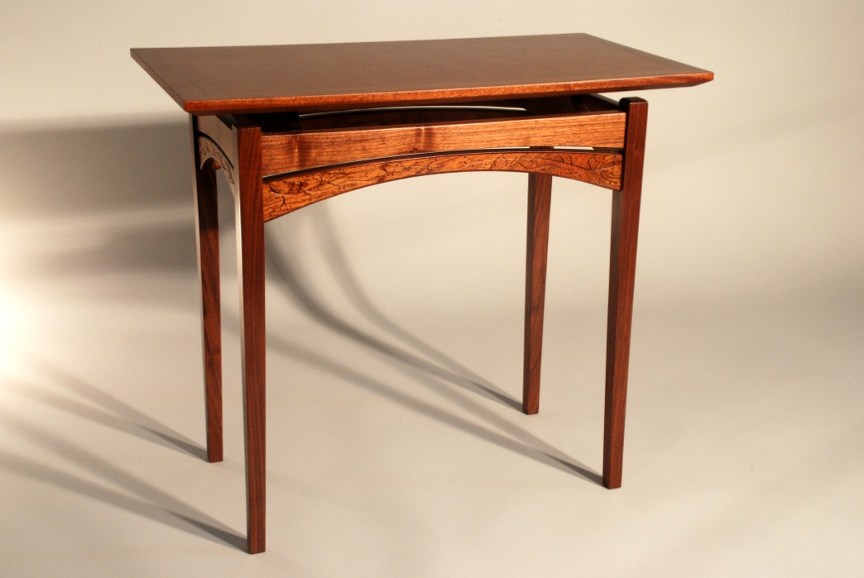
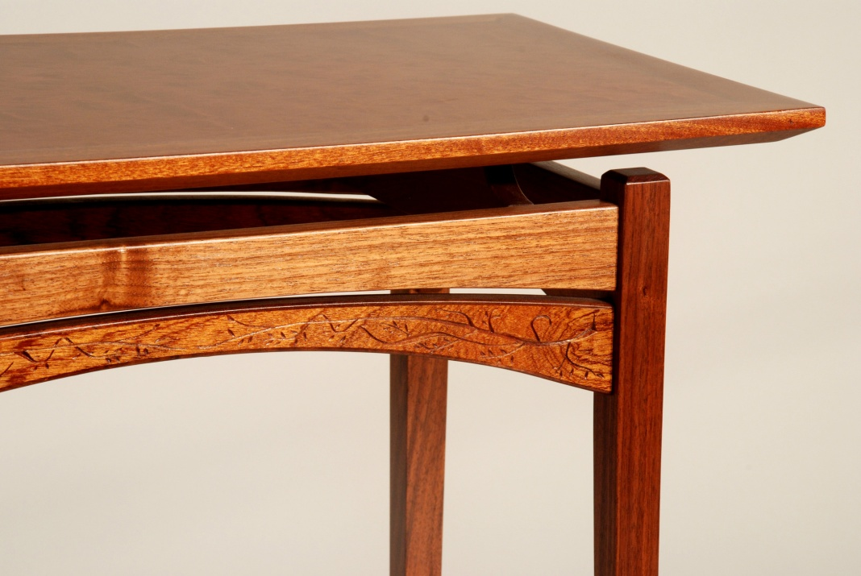
Chip Carving Examples

Slide 8
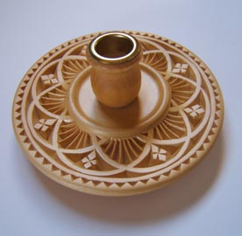
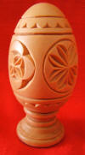
Chip Carving for Woodturners

Slide 9
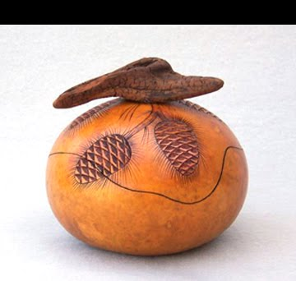
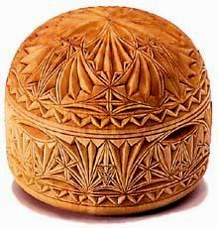
Chip Carving for Woodturners

Slide 10
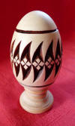
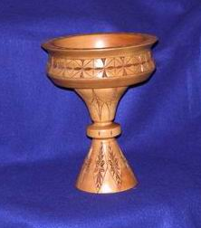
Chip Carving for Woodturners

Slide 11
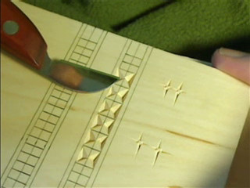
Chip Carving Demonstration

